Slide 2
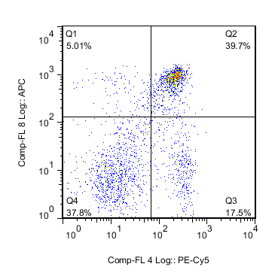
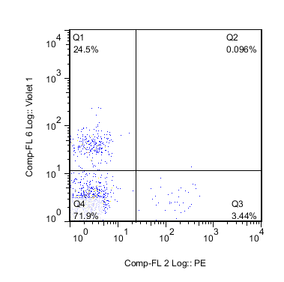
CD8
CD19
CD4
CD11c

Slide 3
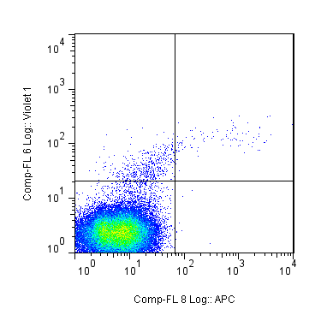
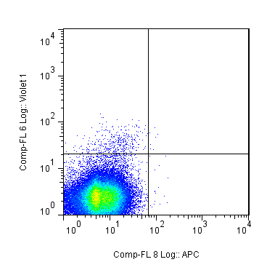
CD19+ Recipient Spleen
7 days
11 days
CD19+IgM+
0.205%
CD19+IgM+
0.008%
CD19
CD19
IgM
IgM
Notes:
CD19+
11.6.15,

Slide 4
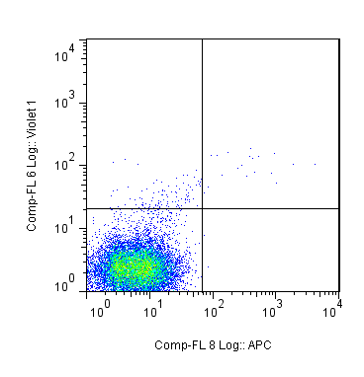
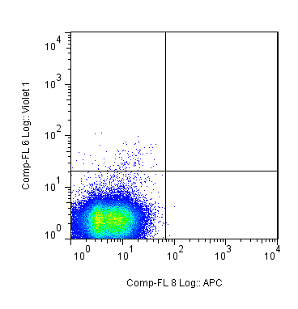
CD19- Recipient Spleen
7 days
11 days
CD19+IgM+
0.141%
CD19+IgM+
0%
CD19
CD19
IgM
IgM
Notes:
CD19-
11.6.15,

Slide 5
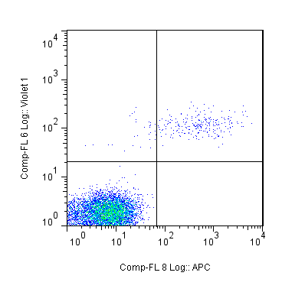
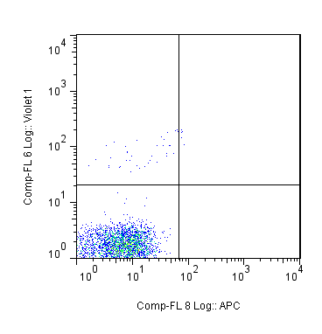
CD19+ Recipient Thymus
7 days
11 days
CD19+IgM+
2.27%
CD19+IgM+
0.181%
CD19
CD19
IgM
IgM
Notes:
CD19-
11.6.15,

Slide 6
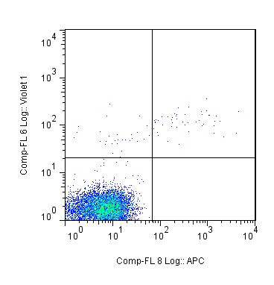
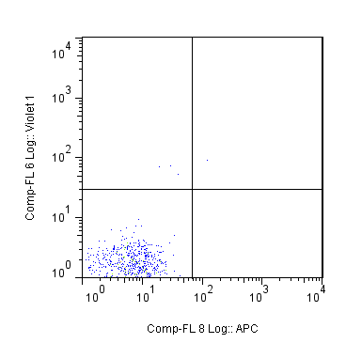
CD19- Recipient Thymus
7 days
11 days
CD19+IgM+
0.406%
CD19+IgM+
0.136%
CD19
CD19
IgM
IgM
Notes:
CD19-
11.6.15,

Slide 7
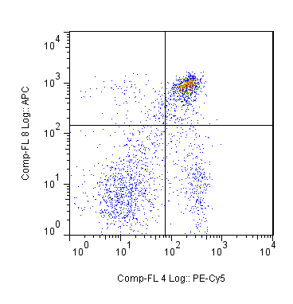
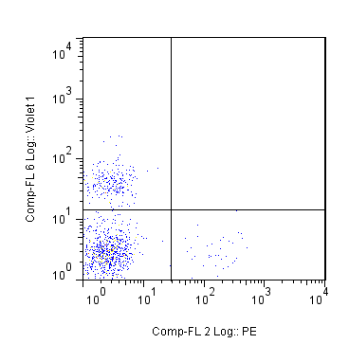
CD8
CD19
38.3%
73.1%
CD4
CD11c
Notes:
Miltenyi 1 round lin depletion

Slide 8
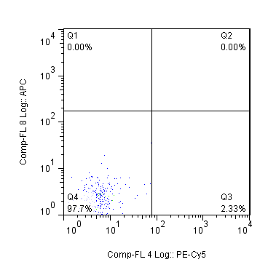
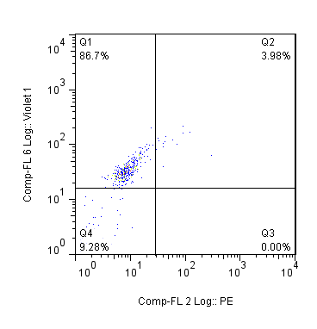
CD8
CD19
CD4
CD11c
Notes:
Miltenyi 2 rounds lin depletion

Slide 9
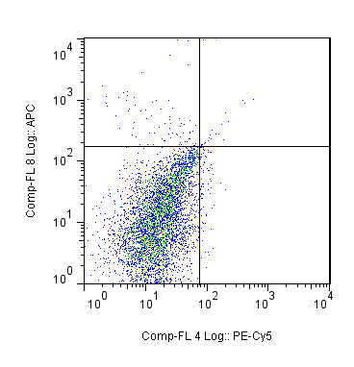
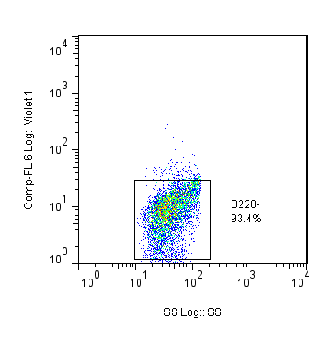
96.3%
CD8
B220
B220-
93.4%
CD4
Side Scatter

Slide 11
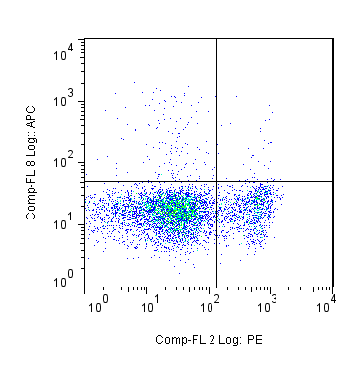
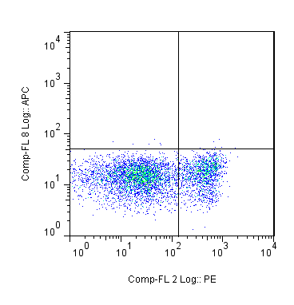
NOD WT
NOD KO
0.440%
0.088%
IgM
IgM
TcRβ
TcRβ
Notes:
10th July
Thy 2 NOD
Thy 6 KO

Slide 12
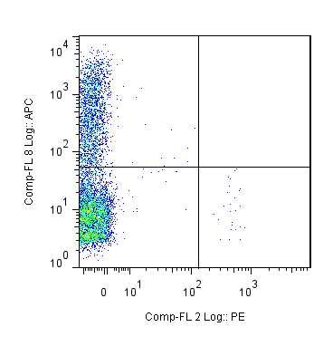
Thymus
Bone Marrow
0.440%
0.00%
IgM
IgM
TcRβ
TcRβ

Slide 13
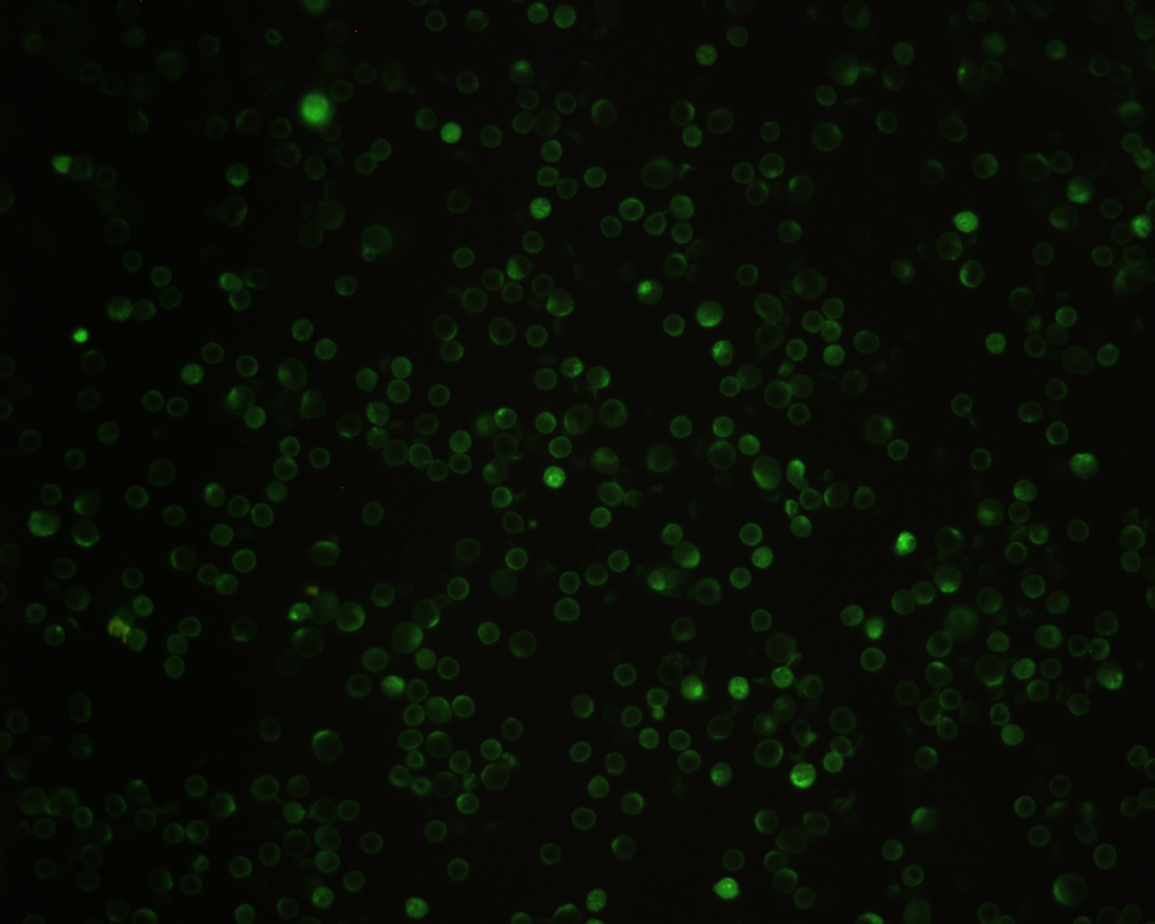

Slide 14
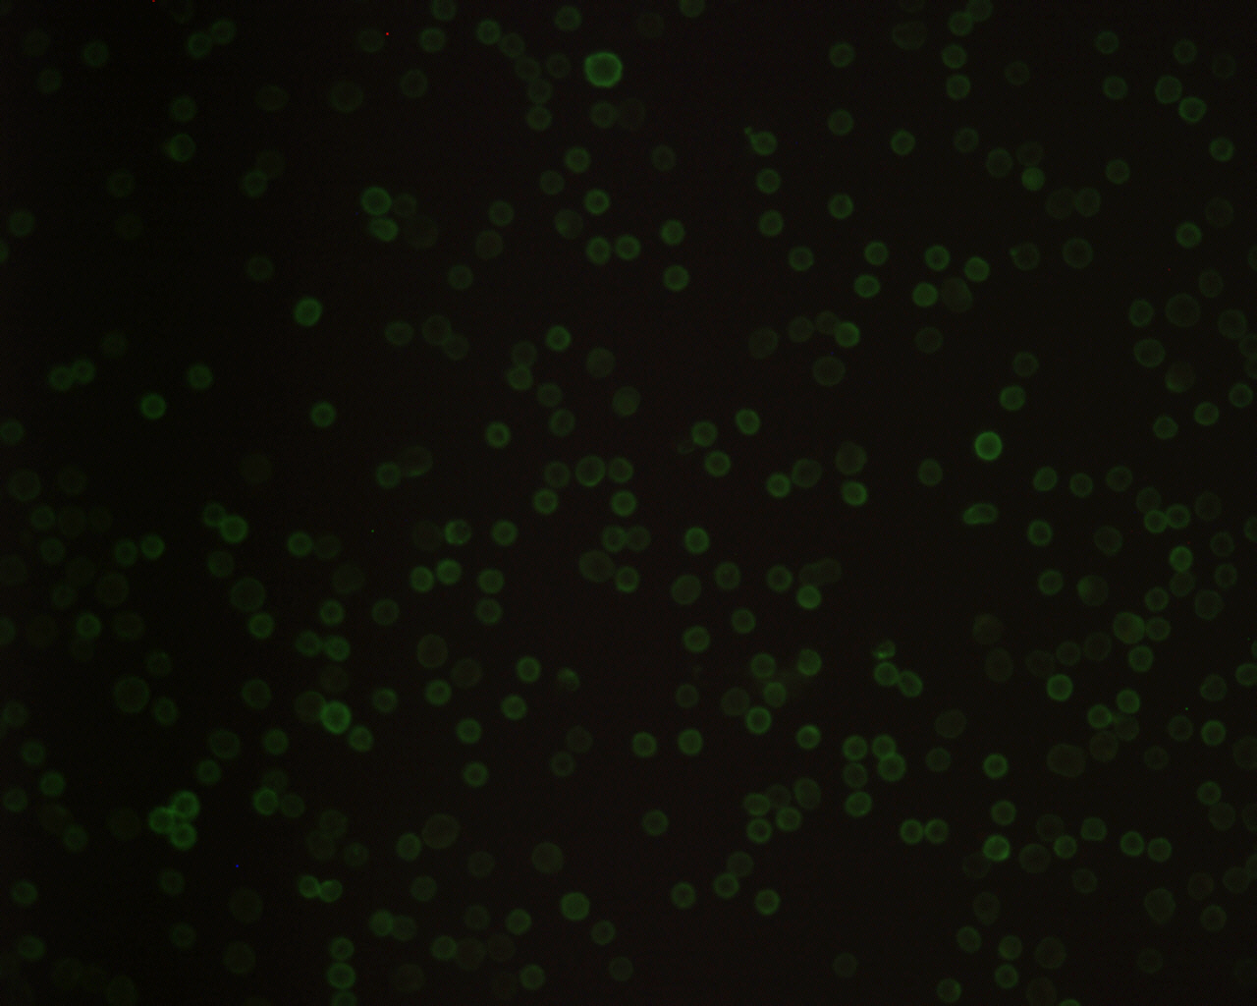

Slide 15
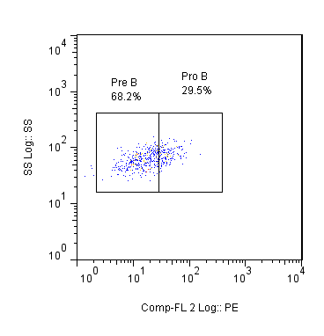
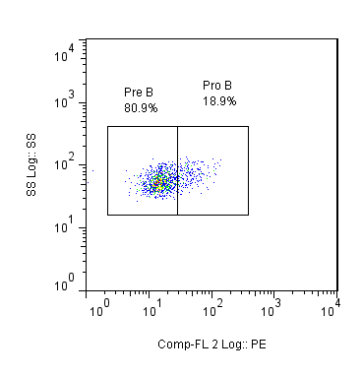
B6
NOD
Pre B
Pro B
Pre B
Pro B
Side Scatter
Side Scatter
CD43
CD43
Notes:
Thymus

Slide 16
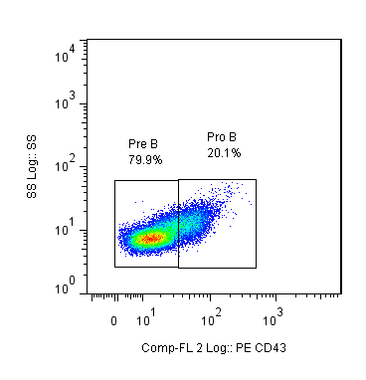
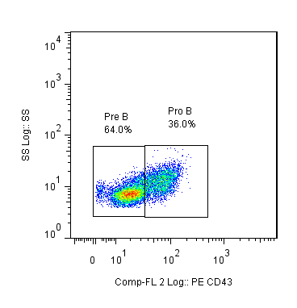
B6
NOD
Pre B
Pro B
Pre B
Pro B
Side Scatter
Side Scatter
CD43
CD43
Notes:
Bone Marrow
NOD correct

Slide 17
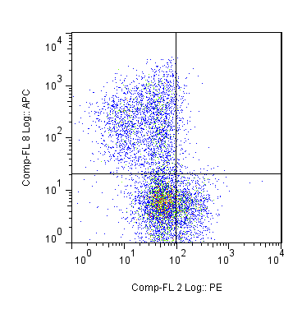
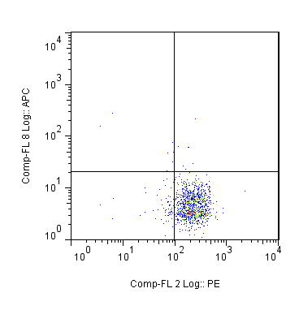
NOD
NOD KO
IgM
IgM
CD43
CD43

Slide 18
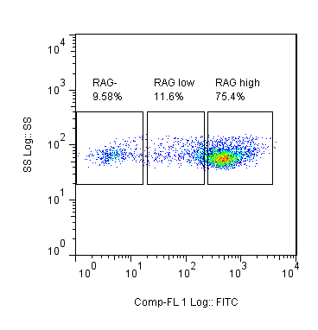
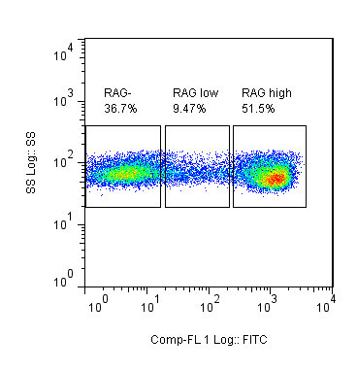
Notes:
BM RAG (LHS) and total thy RAG (RHS)

Slide 19
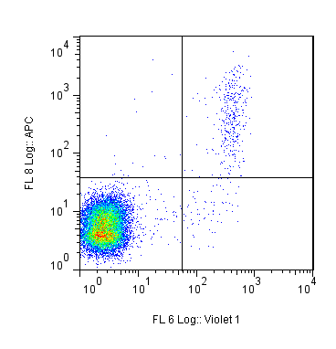
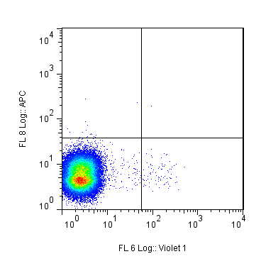
CD19+ Fraction
CD19- Fraction
2.37%
0.005%
IgM
IgM
B220
B220
Notes:
WT → KO

Slide 20
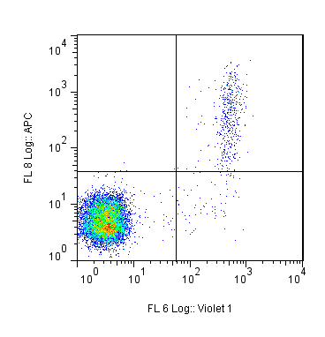
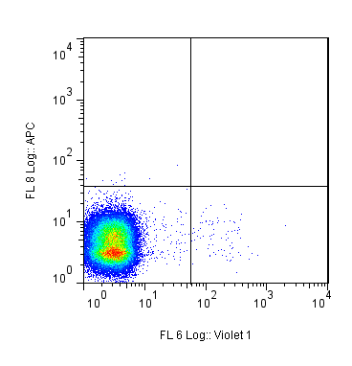
CD19+ Fraction
CD19- Fraction
4.64%
0.002%
IgM
IgM
B220
B220
Notes:
GFP→ nod

Slide 21
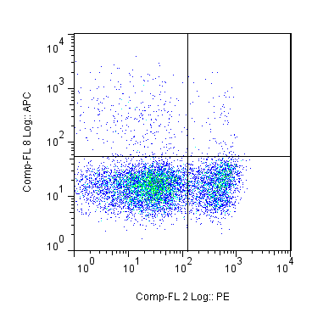
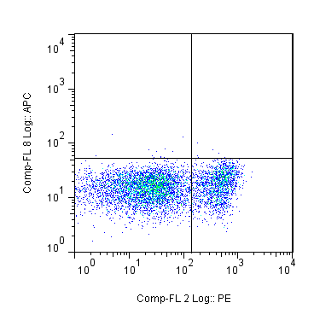
NOD
NOD KO
0.670%
0.054%
IgM
IgM
TcRβ
TcRβ

Slide 22
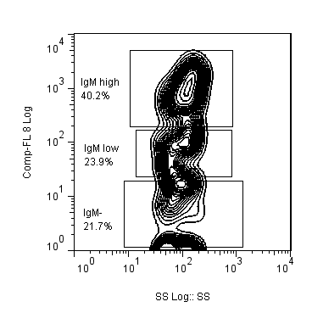
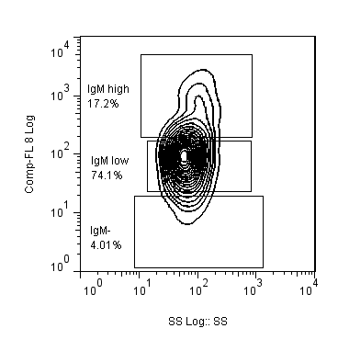
GFP+
GFP-
IgM^{high}
40.2%
IgM^{high}
17.2%
IgM^{low}
23.9%
IgM^{low}
74.1%
IgM
IgM
IgM-
21.7%
IgM-
4.01%
Side Scatter
Side Scatter

Slide 23
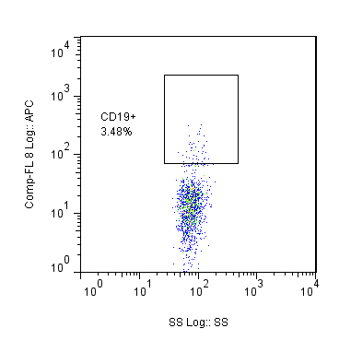
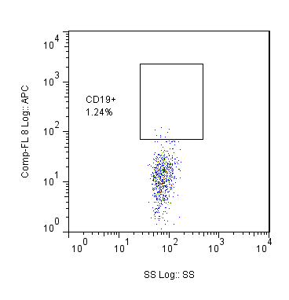
NOD WT
NOD KO
CD19+
3.48%
CD19+
1.24%
CD19
CD19
Side Scatter
Side Scatter

Slide 24
NOD WT
NOD KO
IgM
IgM
CD43
CD43

Slide 25
Fraction | Total cell count | % B cells | Number of B cells /recipient
CD19+ | 133,333 | 2.7 | 1295
CD19- | 3.67 x 10⁷ | 0.005 | 710

